Slide 1

Why Python?
• Open Source
• Simple Syntax
• Extensive packages and libraries
• Used in Robotics, Data Science,
Web Design, Machine Learning
and much more.

Slide 2
Basics of Python
•Operators:
•Inputs in python
•Variables and constants
•Data Types
•Conditional Statements
•Iterative statements
•Functions
•Packages
•Data Structures (Lists,Dictionaries)

Slide 3
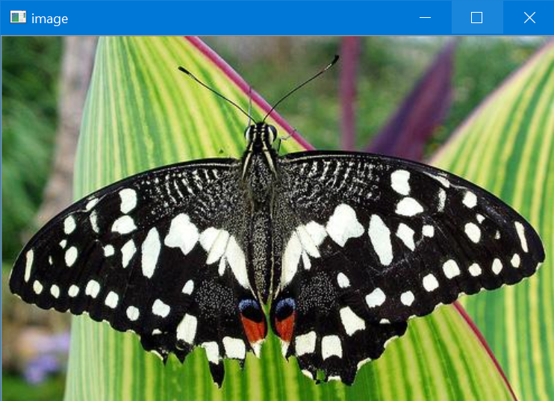
Starting with basics of OpenCv
To read an image:
cv2.imread(‘path/imagename’, flag)
Flag: 0= grayscale
1=colorimage
-1=unchanged
To display an image:
cv2.imshow(‘window-name’,’path of image/variable’)

Slide 4
Video Capturing:
Cv2.VideoCapture(flag)
flag = 0 -> Takes feed from Webcam
file path -> Takes specified video from system
Video Saving: We can specify filename, FPS and dimensions.
FOURCC:FOURCC is short for "four character code" - an identifier for a video codec, compression format, color or pixel format used in media files

Slide 5
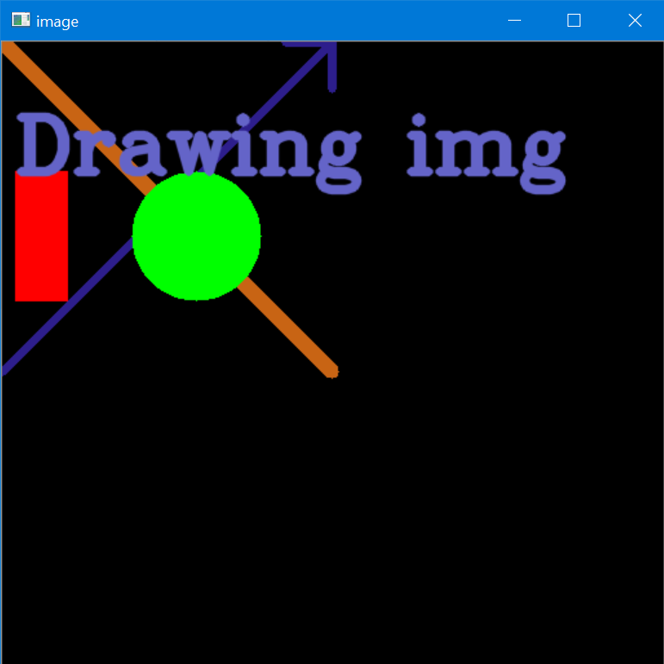
Drawing Objects on canvas
Line:
cv2.line(img, start_pt, end_pt, BGR_color, thickness)
Rectangle:
cv2.rectangle(img, (x1,y1),(x2,y2), color, thickness)
Circle:
cv2.circle(img,centre,radius,color,infill or borderfill)
Puttext:
cv2.putText(img,’name’,start_pt,font_face,color,thickness,line_type)

Slide 6

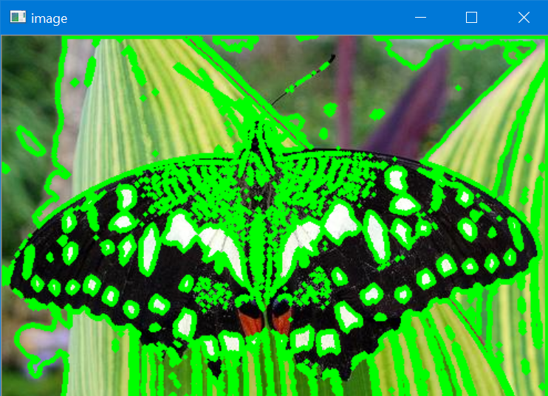
Contours
Contour is a curve joining all the continuous points along the boundary which are having same color and intensity. Useful in shape analysis and object detection.

Slide 7
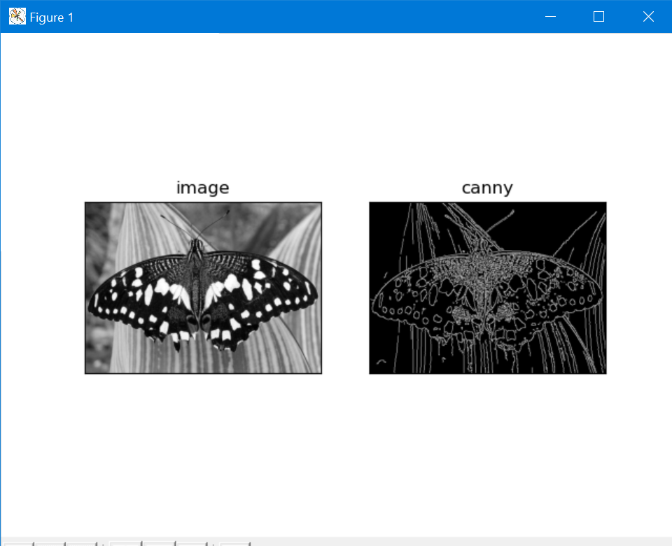
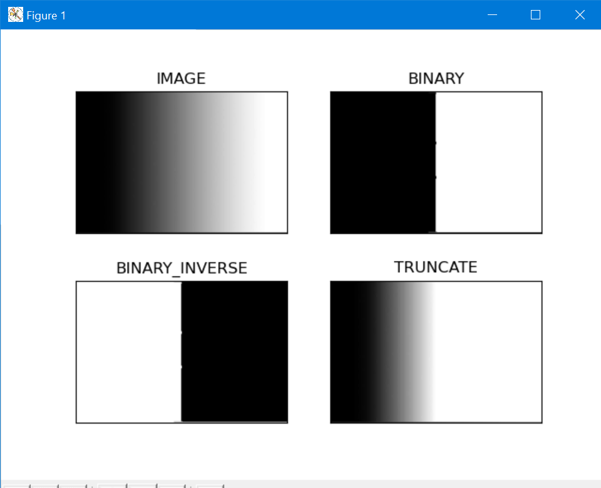
Canny edge detection is an edge detection operator that uses a multi-stage algorithm to detect wide range of edges im images
Thresholding is a segmentation technique for separating an object from its background

Slide 8
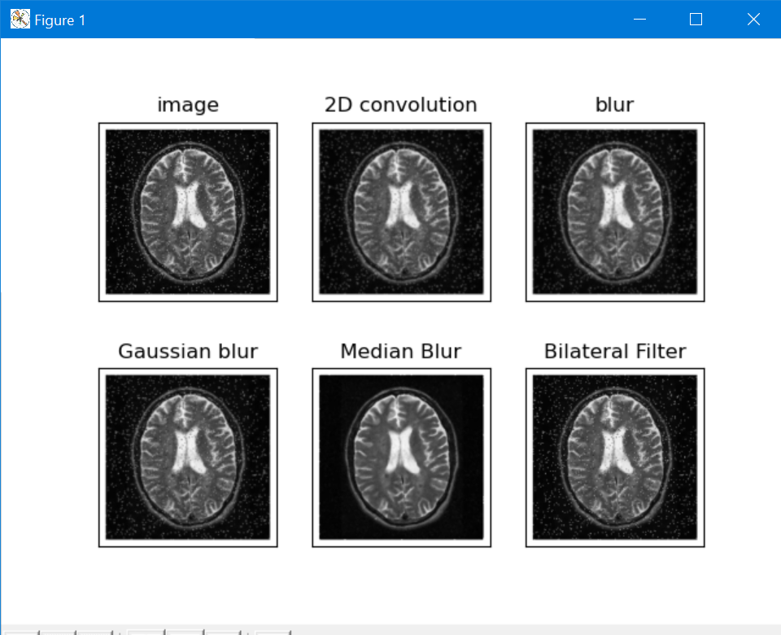
Image smoothing, filtering or blurring is one of the most used techniques in todays world right from our mobile phone to highly capable robots.

